Slide 1

Statistics
- Mukesh Sajjan

Slide 2
Agenda
Descriptive Statistics
Inferential Statistics

Slide 3
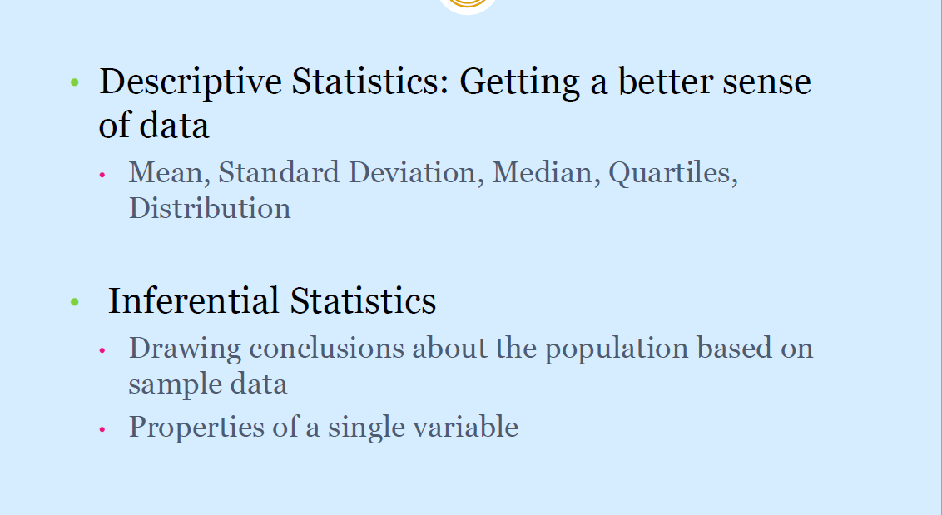
Types of Statistics

Slide 4
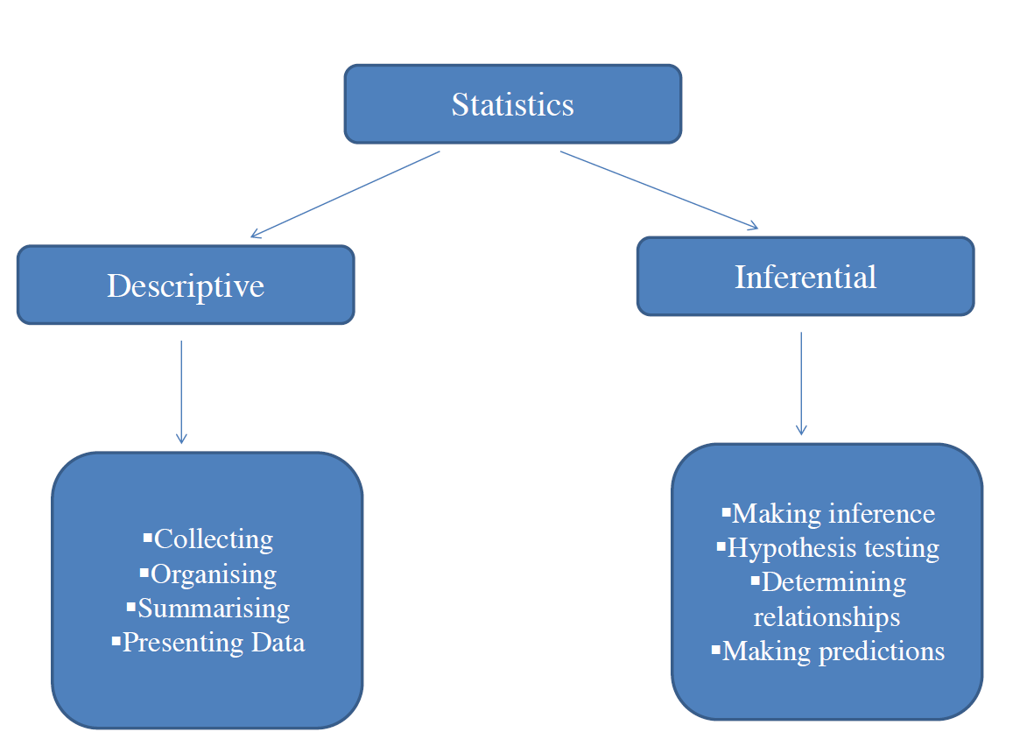
Types of Statistics

Slide 5
Measures of Descriptive Statistics
Central Tendency Measures:
Mean
Median
Mode
Quartiles
Dispersion Measures:
Max and Min Value
Range: Max – Min
Inter-Quartile Range (Q3-Q1)
Standard Deviation

Slide 6
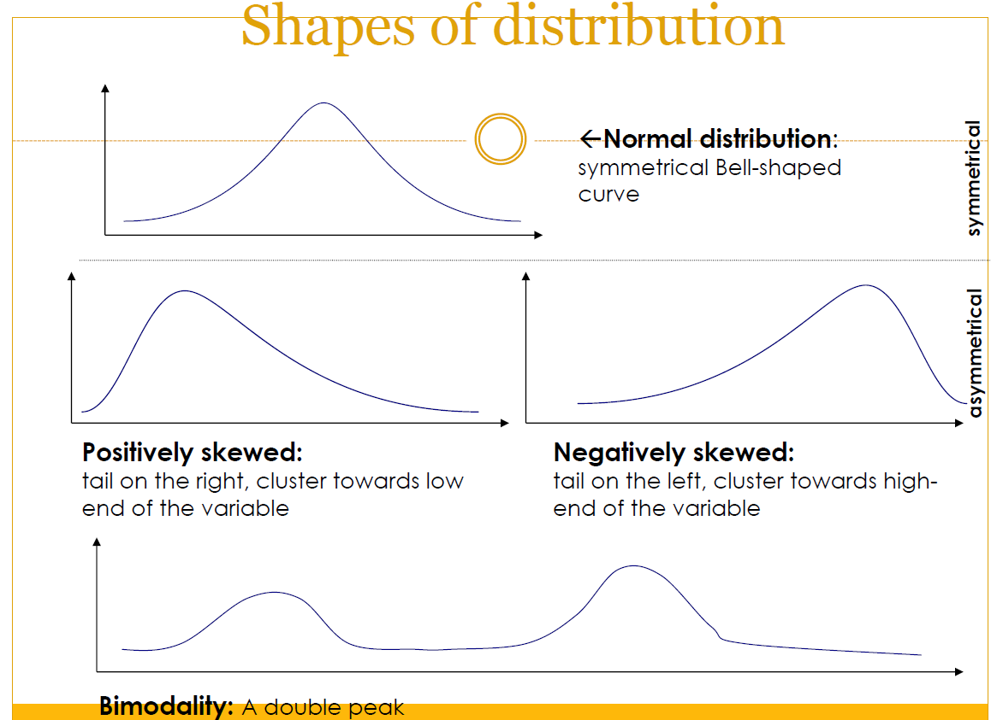
Distribution Shapes - Skewness

Slide 7
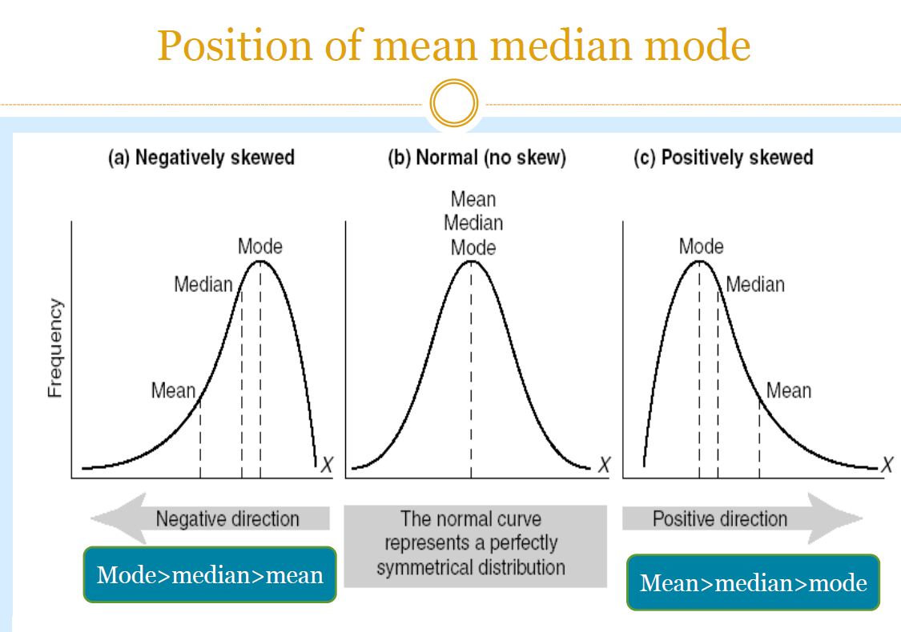
Distribution Shapes - Skewness

Slide 8
Inferential Statistics
Inferential statistics is a branch of statistics that involves drawing conclusions or making inferences about a population based on a sample of data taken from that population.
The goal of inferential statistics is to make predictions, generalize findings, and draw conclusions beyond the immediate data at hand.

Slide 9
Key Aspects of Inferential Statistics
Population and Sample:
Population: Refers to the entire group that is the subject of the study.
Sample: A subset of the population that is selected for the actual study. The characteristics of the sample are used to make inferences about the entire population.
Random Sampling:
To ensure the validity of inferences, the sample should ideally be selected randomly from the population. Random sampling helps minimize bias and ensures that the sample is representative of the population.
Statistical Inference:
Inferential statistics involves using sample data to make predictions or draw conclusions about population parameters. Common inferential techniques include hypothesis testing, confidence intervals, and regression analysis.

Slide 10
Key Aspects of Inferential Statistics
Uncertainty and Probability:
Because inferential statistics involves making predictions about a population based on a sample, there is an inherent level of uncertainty. Probability theory plays a crucial role in quantifying this uncertainty and expressing it in terms of confidence levels or p-values.
Hypothesis Testing:
A common technique in inferential statistics is hypothesis testing, which involves making a statement about a population parameter and assessing the evidence against that statement based on sample data. The results of hypothesis tests help researchers make decisions and draw conclusions.
Confidence Intervals:
Confidence intervals provide a range of values within which a population parameter is likely to lie. They express the level of confidence in the estimate and are often used in conjunction with point estimates.

Slide 11
Hypothesis Testing
A common technique in inferential statistics is hypothesis testing, which involves making a statement about a population parameter and assessing the evidence against that statement based on sample data. The results of hypothesis tests help researchers make decisions and draw conclusions.
With hypothesis testing, there are two hypotheses that is formed generally which are mainly the Null hypothesis and the Alternative hypothesis. Where the Null hypothesis contradicts the assumption made in the alternative hypothesis. We set a significance threshold and test for 2 possible scenarios which are to either
Reject the null hypothesis
ii. Fail to reject the null hypothesis

Slide 12
Types of Tests
Z-test: If population means and standard deviations are known. Z-statistic is commonly used.
t-test: If population standard deviations are unknown. and sample size is small than t-test statistic is more appropriate.
Chi-square test: Chi-square test is used for categorical data or for testing independence in contingency tables
F-test: F-test is often used in analysis of variance (ANOVA) to compare variances or test the equality of means across multiple groups.

Slide 13
Type 1 and Type 2 Error
Type 1 error: When we reject the null Hypothesis, although that hypothesis was true. Type 1 error is denoted by alpha.
Type 2 error: When we accept the null Hypothesis, but it is false. Type 2 error is denoted by beta.

Slide 14
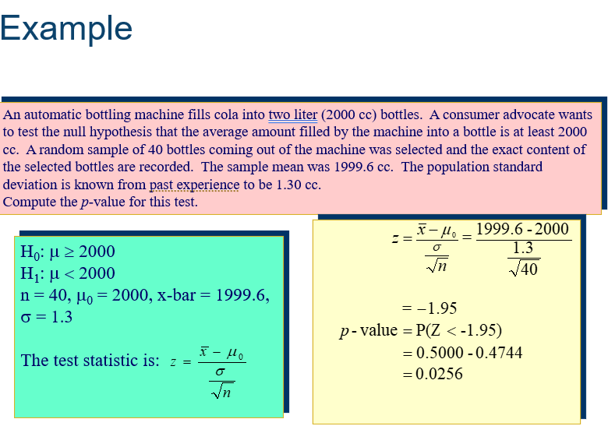
Case Study

